Slide 1
IMPRINT Web Portal
User Guide

Slide 2
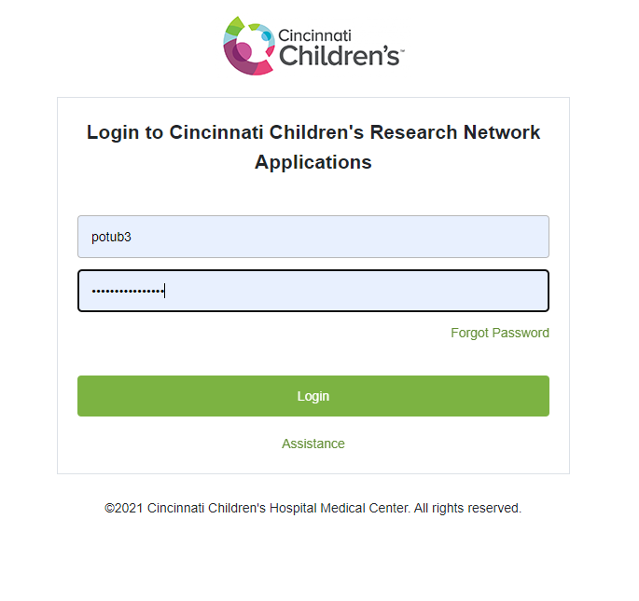
Loading In
https://imprint.research.cchmc.org/
Log in with CCHMC credentials

Slide 3
Portal Contents
Home – Contains overview information each of the three arms (MIC, PIC, SIC) of the IMPRINT study
Query – Can set up a specific cohort with specific criteria sets for further analysis
Results – View the output of a query or a selected report
Reports – List of already set up, saved queries
Imprint Admin – Upload portal for uploading data into specific REDCap projects

Slide 4
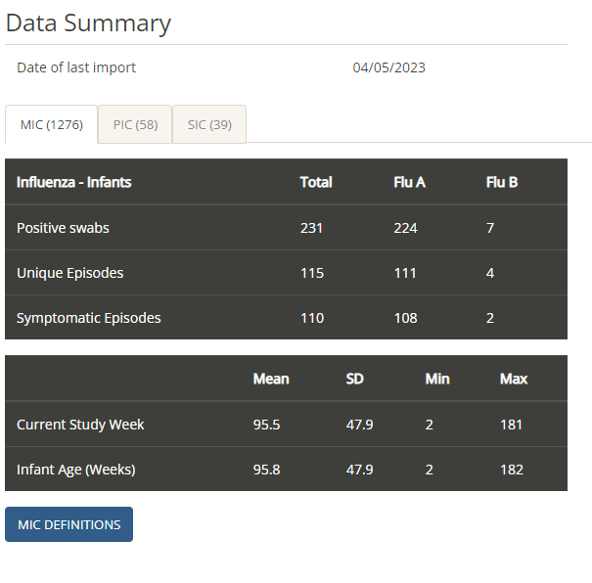
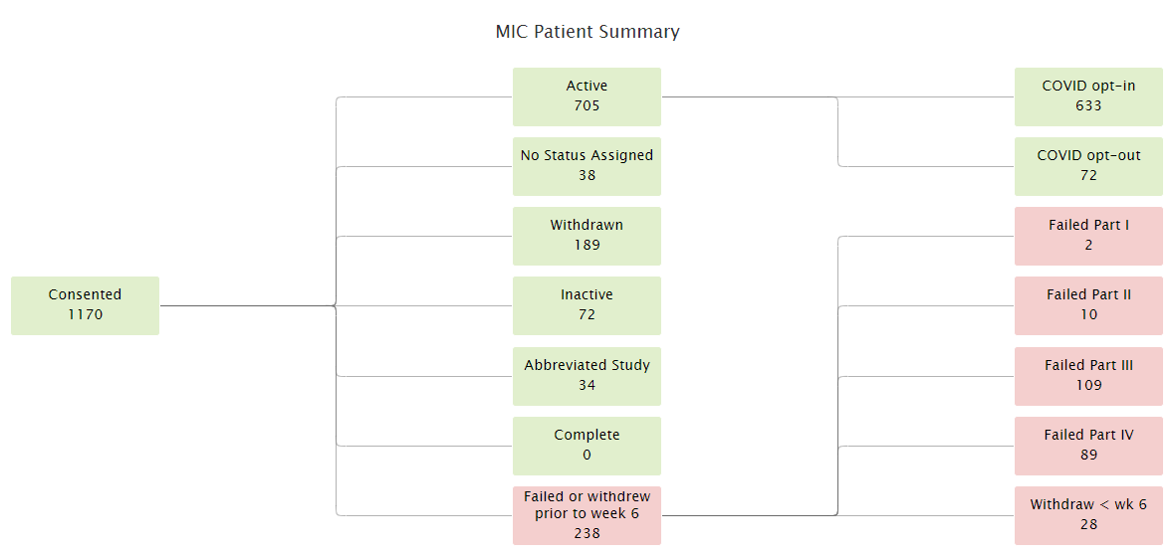
Home
Select between the three study arms to display summary information
Study status distribution flowchart shown

Slide 5
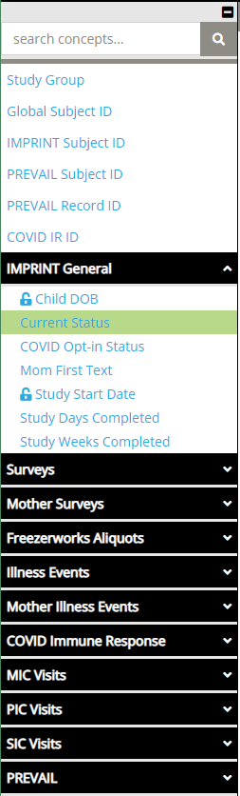
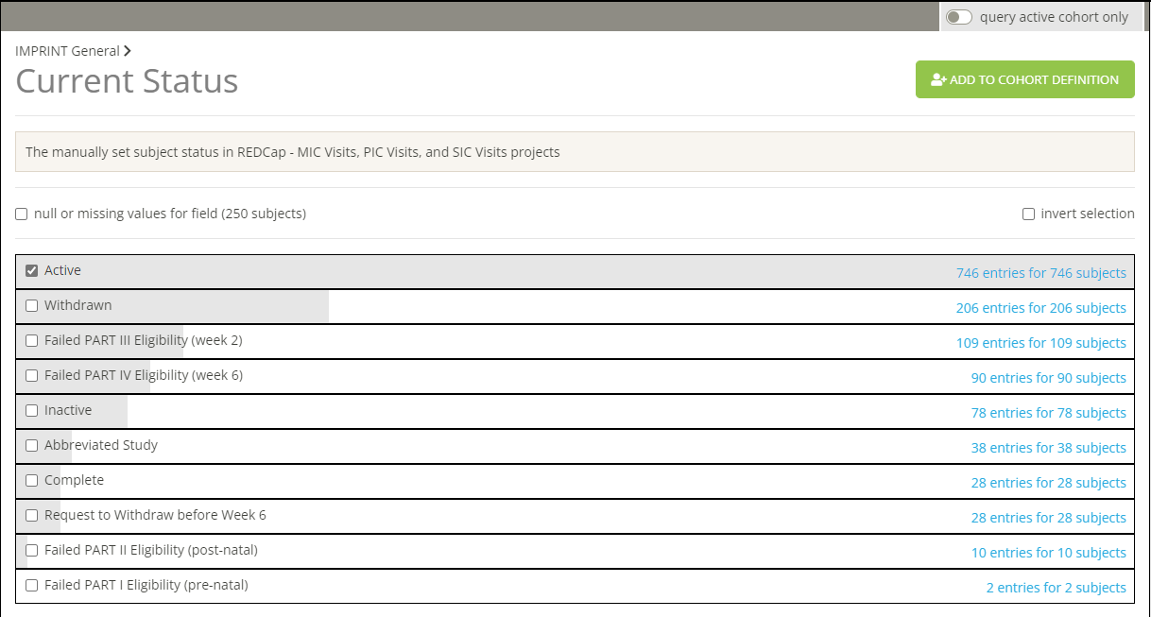
Query
Left-side panel has filtering variables
Variables and data are sourced from REDCap and Freezerworks
Once a variable is selected, it is brought to the workspace in the middle
Variables can also be found by using the “search concepts” bar at the top
Here you can select what groupings you want to include in your cohort by using the “add to cohort” button

Slide 6
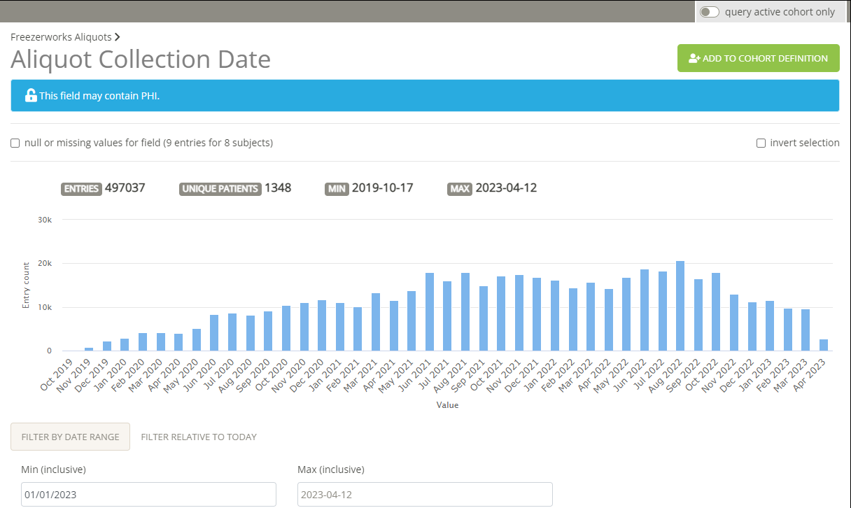
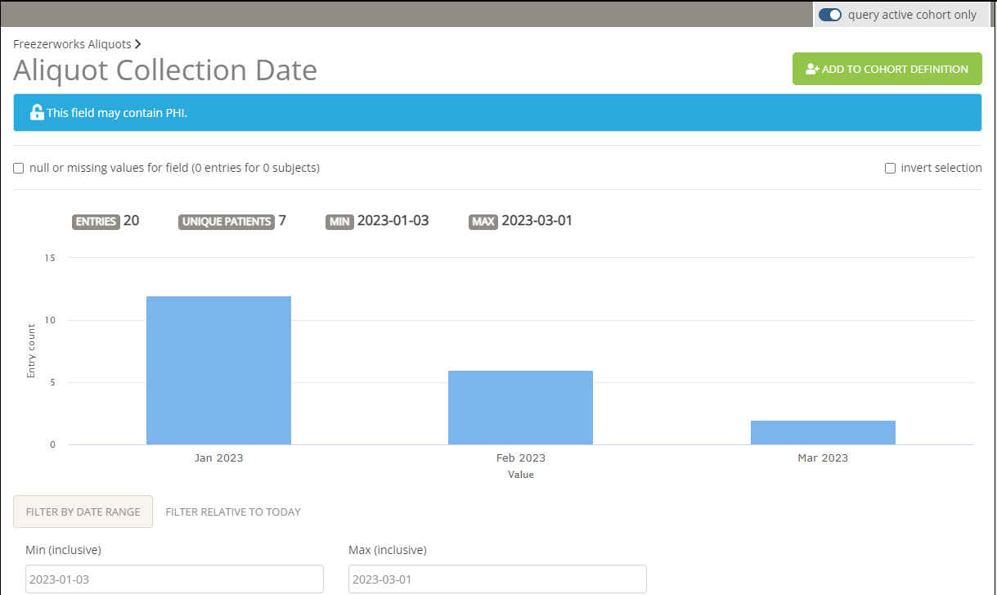
Query
“Query active cohort only” button will limit the display in the workspace to subjects fitting the selected criteria

Slide 7
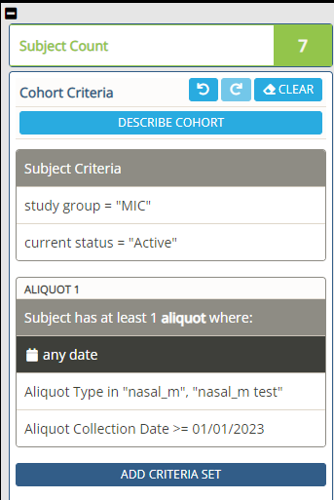
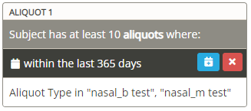
Query
Cohort overview and controls are available on the left side of the workspace
Subject count indicates how many unique subjects fit into the selected criteria
Each grouping criteria is listed and can be further modified
Can make criteria rules on count and time ranges

Slide 8
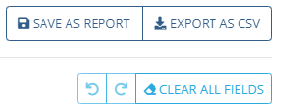
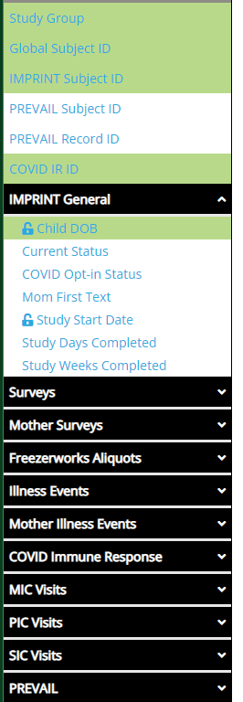
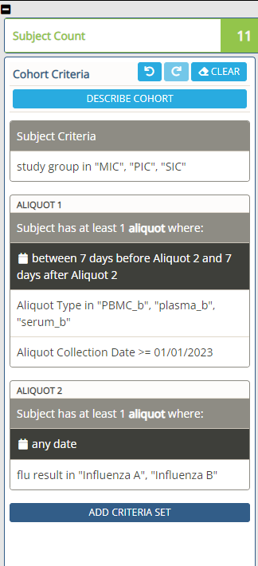
Results
Dataset is generated based on the criteria set in the Query tab
Left side panel has variables that can be selected to be included in the result output table
Right side panel lists the criteria set for the data
Above the table, there are options to save the results as a report in the Report tab
Can also export the table directly as a CSV file here

Slide 9
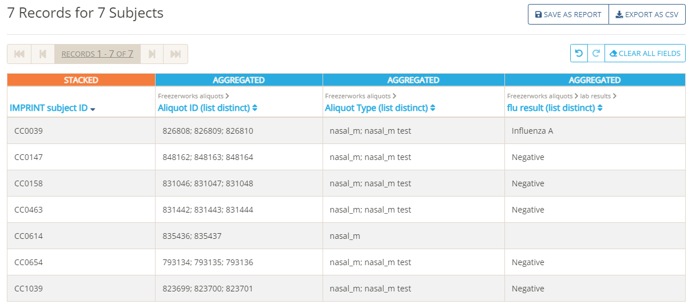
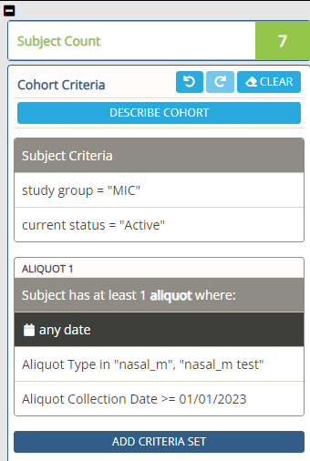

Results
Above is an example of an output table for the criteria set presented on the right
How the data is presented can be edited on a column-by-column basis by hovering the column header and selecting the edit button

Slide 10
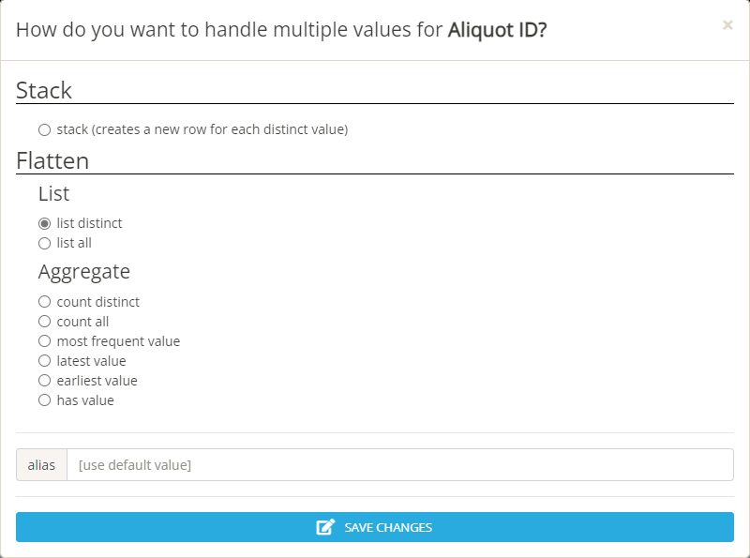
Results
Above is the column edit options available for the aliquot ID variable
You can choose to have a separate row for each aliquot ID (stack) or maintain the combined rows
Furthermore, you can choose to list every aliquot ID, keep the first one, the last one, etc.
Can also change the name of the column

Slide 11
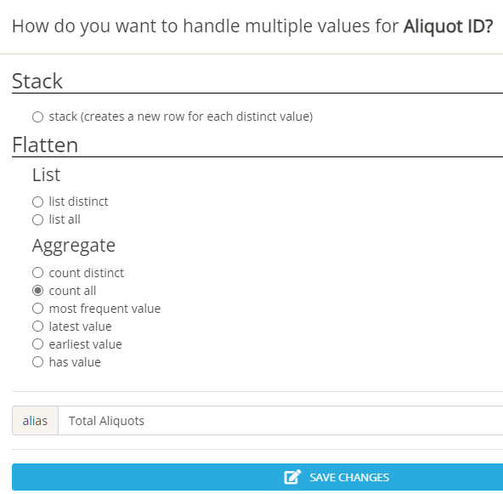
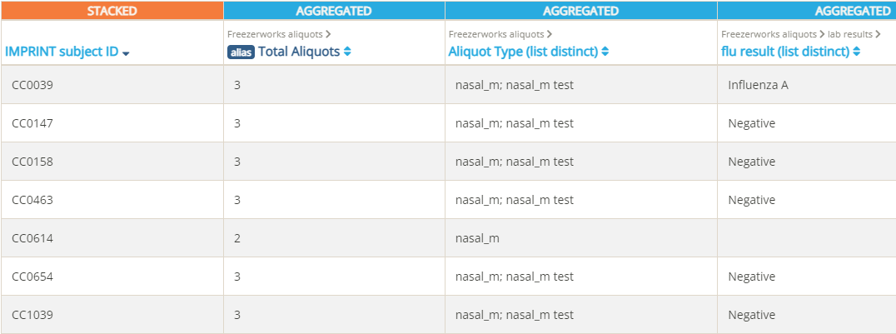
Results
Here we will have the total number of aliquots presented, and I have changed the name of the column to reflect this
Below is the new results table

Slide 12
Reports
Saved reports are listed here in the “All Reports” tab
You can star reports and they will show up in the “Starred” tab

Slide 13

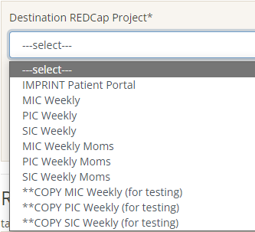
IMPRINT Admin
Select which REDCap project you want to upload data to from the drop-down menu
Then choose the file you wish to upload
When uploading files it is important to remember:
Use proper variable names for column headers,
Values are within the response limits for ordinal, nominal, and binary variables
The “redcap_event_name” value refers to the correct instrument in the REDCap project you are trying to upload data to

Slide 14
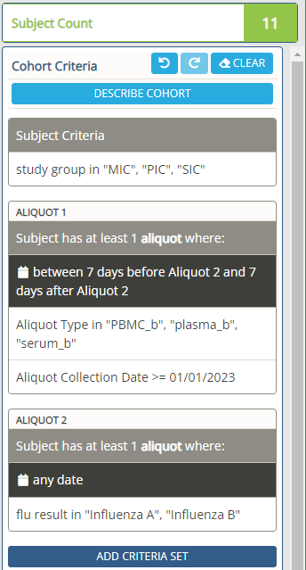
Exercise
Please try to recreate the cohort criteria set shown on the left

Slide 15
Exercise Solution
Study group MIC, PIC, and SIC can be found in the top “Study Group” section
Aliquot type can be found in the “Aliquot Type” section in the “Freezerworks Aliquots” report selection on the left side
Aliquot collection date can also be selected from the “Freezerworks Aliquots” report
Flu result type can be selected from the “Lab Results” sub report in the “Freezerworks Aliquots” report
Examine the output in the Results tab

